Slide 1
transcultural entanglements in "A Casualty of Power" by Mukuka Chipanta
A presentation by Lena Müller
& Jade Fernell

Slide 2

Structure
The Chinese-Zambian relationship in the novel
>> Governmental structures
>> Characters relationship
Background
>> Chinese mining operations
>> Corruption in Zambia

Slide 3

The Governemental relationship in the novel
China Metals and Mining Company (CMMC) 🤝Agreement with the
Zambian government
Chinese government:
Interested in Zambian's resources: copper
Take advantage of the country's poverty
Put pressure on the Zambian government and mine workers
Zambian government:
Dependent on outside support
Improved Infrastructure: new malls and stadions
➔ Zambian government profits financially
Mine workers:
Labour conditions deterioate since CMMC took over the mine plants

Slide 4
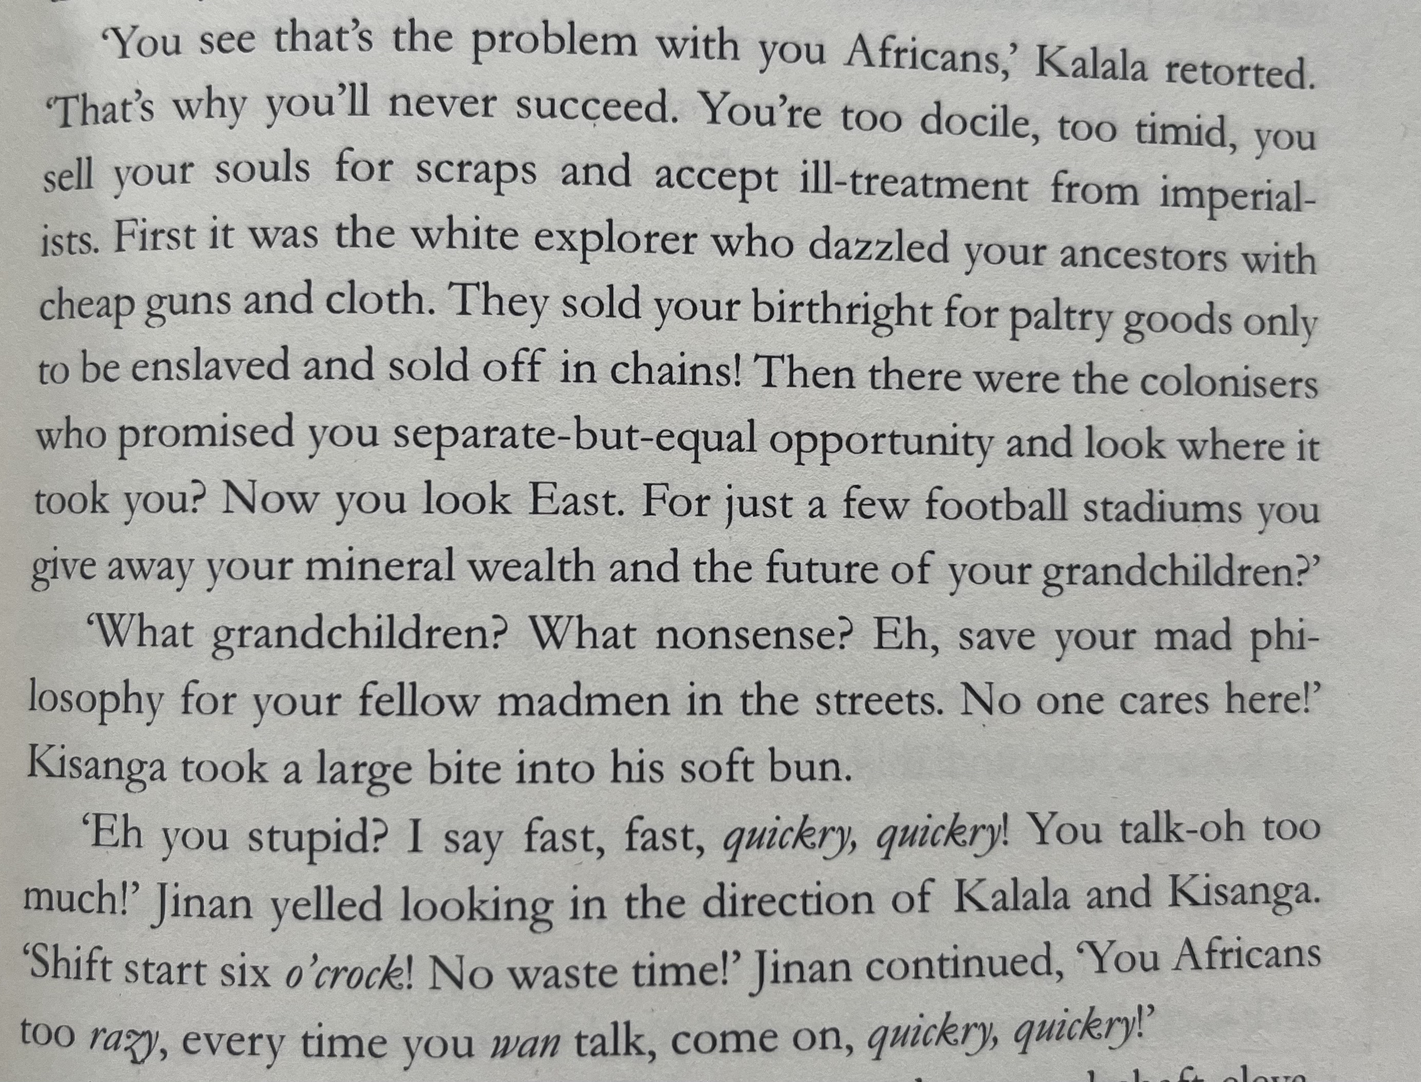
Book Scene: Jinan & the Mine Worker's
Jinan's character reproduces stereotypes
"hard-working" Chinese and "lazy" African
>> clash of language, work ethic & values
The mine worker are unhappy with the labour conditions
>> More hours, less money, and unsafe environment
p.138-141

Slide 5
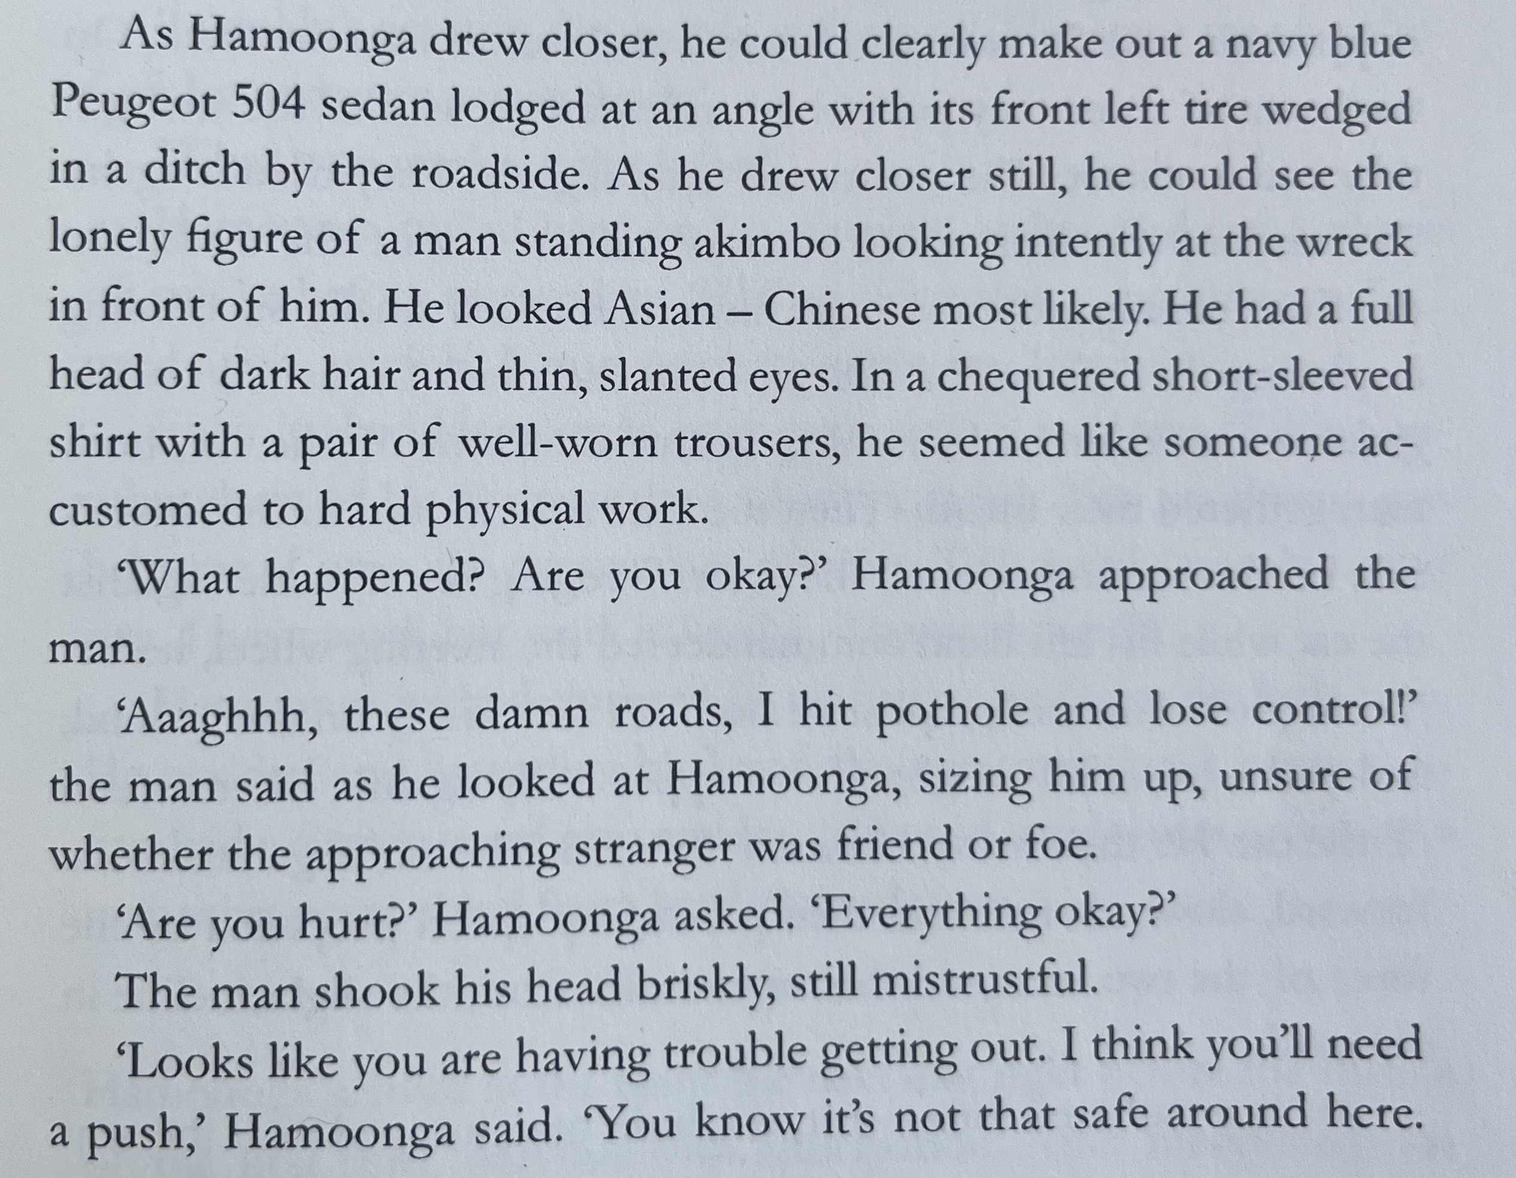
Book Scene: Hamoonga & Jinan Meet
Setting:
Kitwe, Copperbelt Province, Zambia
January 2011, three months after Hamoonga's return from prison
He was looking for a job all day at the plants – unsuccesfully
On his way home, he witnesses a car driving into a ditch
p. 117-119

Slide 6
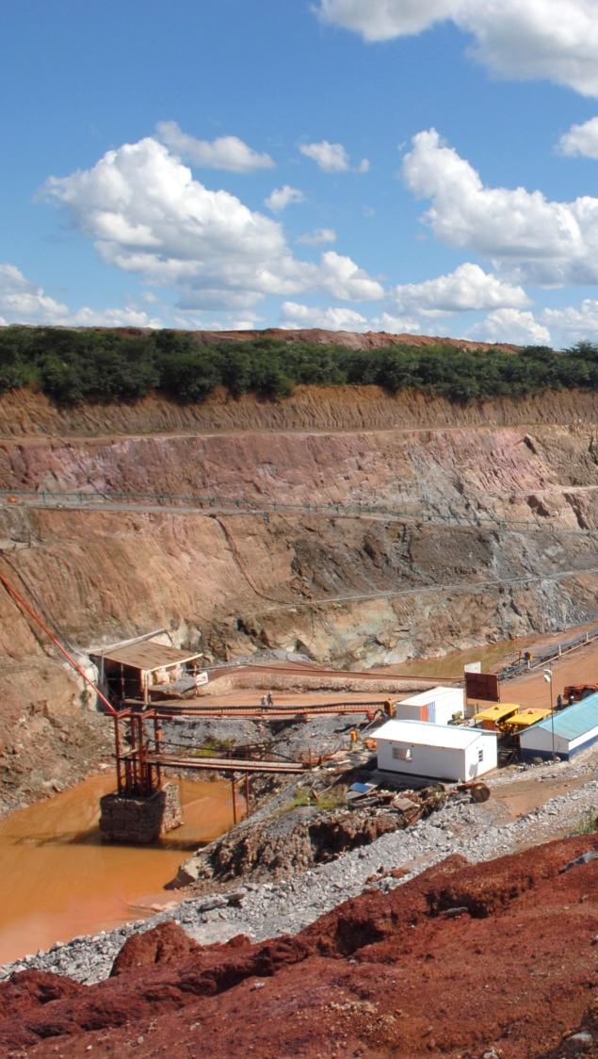
Empathy & Complexity: Their Relationship
Non-work-context:
mutual respect & mutual human vulnerability (commonality)
both suffered tramatic loss, dramatic past
Work-context:
Jinan speaks harsher, but still with respect
Jinan respects his hard work ethic & academic knowledge
Hamoonga is thankful for the job
➔ UNEQUAL position
https://assets.bwbx.io/images/users/iqjWHBFdfxIU/ikCuJVaHQM6s/v1/-1x-1.jpg

Slide 7

Background
Novel succeeds to display complex relationship that is based on human interaction
especially through Chinese mining operations
Language, work ethic, and values clash (in scenes involving Chinese supervisors and African mine workers)
stereotypes like "Black Peril" and "Yellow Peril" discourses exacerbate the ability to see nuanced relationships
Novel challenges to review cultural perceptions

Slide 8

About cultural influences
literature, especially fiction, can help humanize African-Zambian relationships
disrespect towards local customs/traditions
language barrier creates mistrust and misunderstandings
expectations on work ethic and ambition differ greatly

Slide 9


The "South"
South-South cooperation is the leading perspective
Global South as a concept and critique
both parties are considered the "Other", nevertheless Western values and stereotypes remain to dictate the discourse
through humanizing the "Other" the novel raises empathy for both sides due to its authentic representers (Hamoonga & Jinan)

Slide 10


Question?
To what extent does the novel display the narrative of the 'South solidarity'?

Slide 11


About corruption
One of the key aspects that disrupt the solidarity narrative ergo support the 'huminization' of the novel
seen as a 'real-world issue' that can also affect individuals
Acts of bribery or abuse of power are not ascribed to both parties which contributes to the mulifaceted description in the novel

Slide 12
Sources
Chipanta, Mukuka (2016). A Casualty of Power. Weaver Press, Zimbabwe.
Shi, Flair Donglai (2021). “Out of the Yellow/Black Peril Discourse: Humanizing China–Africa Relations in Mukuka Chipanta's A Casualty of Power.” Penn State University Press. Comparative Literature Studies, Volume 58, Number 3, 2021, pp. 623-646

