Slide 1

China in Africa: A Zambian case
Angelika Lucia 26.06.2025
China, India, and Africa: Literatures of the Indian Ocean
Dr. Malreddy

Slide 2
Today‘s agenda
Discovering Zambia:
Task 1: Learning about Zambia
History of Zambia
Zambia after independence
Chinese workers in Zambia
Chinese-Zambian relations
Emerging conflicts
Task 2: Widening the perspective through the documentary „Empire of Dust“

Slide 3

Discovering Zambia
"Dieses Foto" von Unbekannter Autor ist lizenziert gemäß CC BY

Slide 4
Task 1: Learning about Zambia
Research a few facts about Zambia with focus on these three given categories:
  Geography
  Demography
  Tourism
Exchange your findings with a partner.
Reflect on what kind of image of Zambia these facts convey. Was China (or Chinese workers) mentioned during your research?

Slide 5
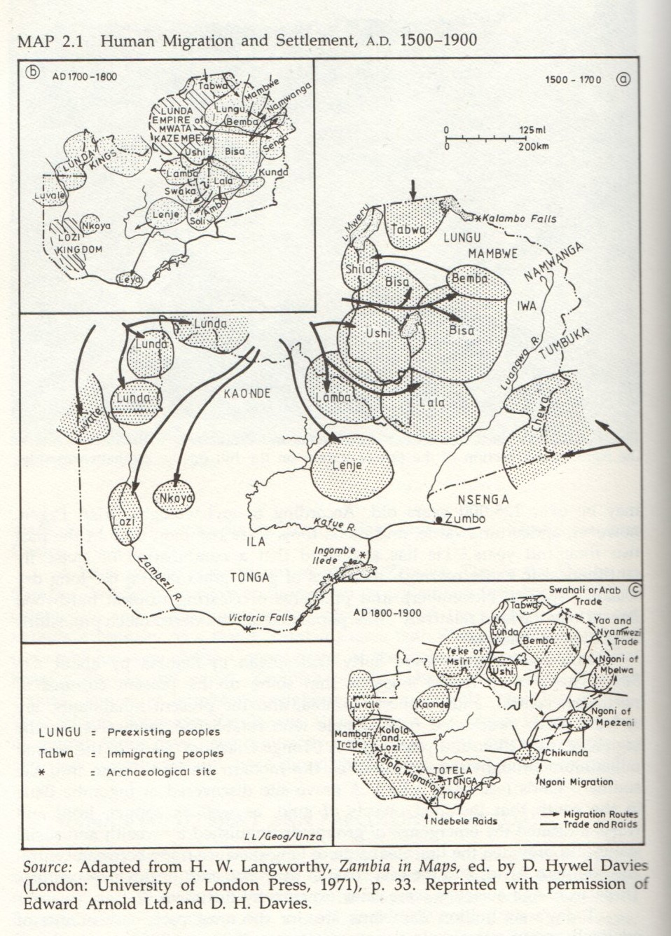
History of Zambia

Slide 6
History of Zambia
Colonial history:
David Livingstone expressing interest in the territories of today‘s Zambia
“Scramble for Africa” leads to the Berlin Conference in 1885:
  At first, Cecil Rhodes takes control over the territories through tricky agreements
  Then, full occupation by the British South Africa Company
  By 1895, the establishment of Northern Rhodesia
Way to independence:
  In 1950s and 1960s, the attempt to establish a federation including other lands under British rule
  Rising protests against the federation – national mobilization leading to independence in 1964

Slide 7
Zambia after independence
Kenneth Kaunda – the first president of Zambia between 1964 and 1991
  Instead of establishing democracy, Kaunda introduces dictatorship under the idea of ‘socialist revolution’
In 1980s and 1990s, increasing protests against Kaunda’s rule, which lead to the establishment of democracy with multi-party system – Frederick Chiluba as president
Slow shift towards fully functioning democracy
Today: Hakainde Hichilema upholding democratic freedoms

Slide 8

Chinese Workers in Zambia

Slide 9
Chinese-Zambian relations
History
Zambian Immigration data
First phase: 1949 – 1979
  Political support and aid for infrastructure
Second phase: 1979-1999
  Politics of openness by Deng Xiaoping – grabbing global economic opportunities
  Begin of economic collaboration between Zambia and China
Third phase: 1999 to today
  Intensification of Chinese investments in Zambia
Increased Chinese migration to African countries
Proper numbers hard to estimate due to the lack of infrastructure – danger of misuse and false interpretation of the data
Numbers differing according to the type of Chinese workers entering Zambia

Slide 10

Emerging conflicts
Often protests led by Zambian workers due to poor working conditions and low wages:
  In 2008, a protest at the Chambeshi Cooper Smelter led to violent riots and dismissal of the involved Zambian protesters
  In 2010, Zambian workers were shot by Chinese managers after protesting at the Collum Coal Mine
In some cases, China did not play dominant role but was obliged to comply with regional laws

Slide 11
Task 2: Widening the perspective through the documentary „Empire of Dust“
Reflect on the stereotypes you know about Chinese and African workers. Are there any similarities? Or: do they differ from each other? Share your thoughts in class.
Watch a fragment (19:44-25:57) from the documentary „Empire of Dust“. Pay attention to the stereotypes conveyed in this fragment (https://www.youtube.com/watch?v=kOkrYW3vF0o&t=1536s&ab_channel=mstdve)
Compare your findings with the previous discussion. Do these stereotypes differ from those you already knew? What do you think where they come from?
One of the Chinese workers says: “We‘re higher on the social ladder than them“ (25:36). How does it impact the relationship between Chinese and African workers?

Slide 12
Thank you for your attention!

Slide 13
Bibliography
Burdette, Marcia M. Zambia. Between two worlds. Westview Press, 1988.
Leslie, Agnes Ngoma. “Zambia and China: Workers’ Protest, Civil Society and the Role of Opposition Politics in Elevating State Engagement.” African Studies Quarterly, vol. 16, no. 3–4, Dec. 2016, pp. 89–106.
Postel, Hannah. “Moving Beyond ‘China in Africa’: Insights from Zambian Immigration Data.” Journal of Current Chinese Affairs, vol. 46, no. 2, 2017, pp. 155–74.
Rapanyane, Makhura B. “China–Zambia Political and Economic Relations in Historical Context.” Africa’s Public Service Delivery and Performance Review, vol. 8, no. 1, 2020, pp. 1–6.
Roberts, Andrew. A History of Zambia. Heinemann Educational Books, 1976.
Sardanis, Andrew. Zambia. The First 50 Years. I.B. Tauris, 2014.

