Slide 1

No Picnic on Mount Kenya
By Felice Benuzzi

Slide 2
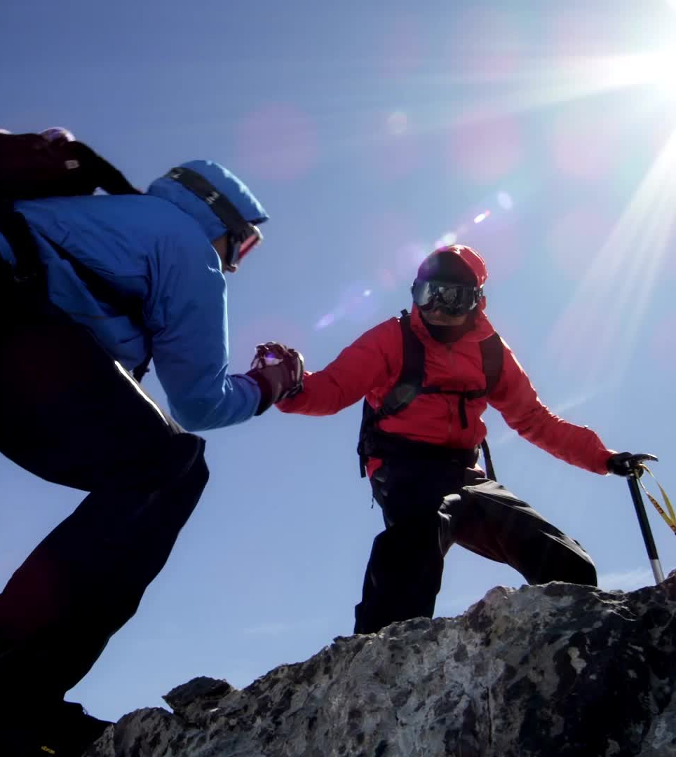
Outline
The Sublime
Adventure as Resistance
Conquest of the Self

Slide 3
The Sublime
Mount Kenya is the central sublime object
„It was the sight of the mountain that saved me“
Mountain becomes a spiritual symbol not just a geographical one

Slide 4
Adventure as Resistance
Adventure is seen as a moral and psychological necessity
„Were not escaping from something, but to something“
The climb is dangerous and life threatening but the alternative is spiritual death

Slide 5
Conquest of the Self
The men are not interestetd in claiming land nor do they want to prove something
„To be defeated is only to be defeated if you accept defeat“
They are rediscovering their personal dignity

Slide 6
Discussion
Can the sublime still be experienced in the age of Instagram etc.? Or has something essential been lost?
Is Benuzzis climb ethical? He breaks rules and risks lives. How do you jugde his motives and actions?

