Slide 1

Documentary: Inside the Territory of Sri Lanka’s Tamil Tigers
Isabel Yian Zi Ploeger

Slide 2
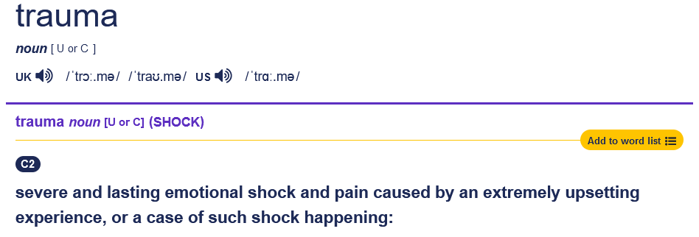

Slide 3
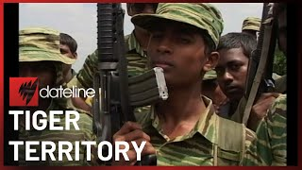

Slide 4
Sri Lankan Civil War as a long term individual and collective trauma

Slide 5
Structure
Historical and Political Context of the Civil War
  Causes
  Main Actors
Timeline
Documentary
Final war Phase
Sources

Slide 6
ethnic tensions between Sinhalese and Tamils
  British colonial rule: favored Tamils, creating resentment among the Sinhalese majority
1948: Independence from Britain
  Sinhalese majority began discriminating against Tamils to regain power
Sinhala Only Act (1956)
Standardisation at Sri Lankan universities
Buddhism as nation’s primary religion (1972)
Burning of Jaffna library (1981-1982)
Increasing violence against Tamil civilians
Historical and Political Context of the Civil War (1983-2009)
CAUSES

Slide 7
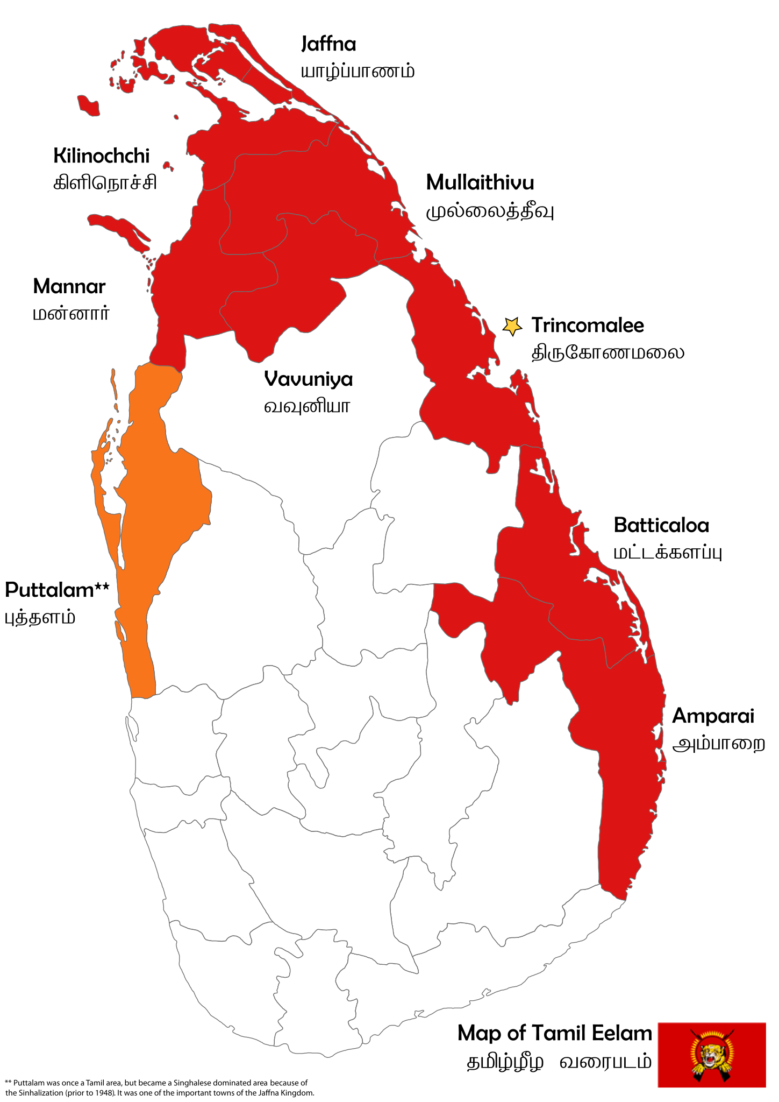
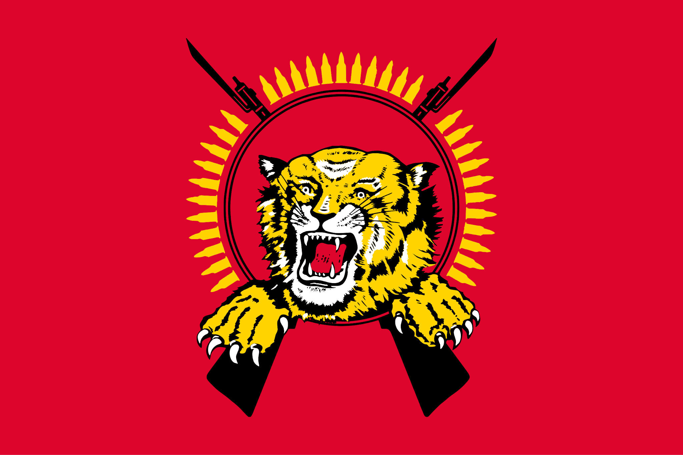
Tamil Eelam
Liberation Tigers of Tamil Eelam

Slide 8
Tamil Tigers (LTTE)
founded in 1976 (Velupillai Prabhakaran)
highly organized (police, school,...)
listed as terrorist organization (suicide bombing, child soldiers,...)
Goal: establish an independent Tamil state
Sri Lankan Government
dominated by Sinhalese-Buddhist majority
systematic discrimination against Tamil minority
backed by state military forces
Goal: preserve national unity and prevent the country from being split
Historical and Political Context of the Civil War (1983-2009)
MAIN ACTORS

Slide 9
Timeline
1983
1983-1990
1990s
2002-2005
Outbreak of Civil War
Escalation and Foreign Intervention
Major Violence and Assasination
Ceasefire and Peace Talks
July: Black July pogrom
Trigger: Killing of 13 Sinhalese soldiers by Tamil Tigers
Anti-Tamil pogrom: violent riots and massacres targeting Tamil civilians (~3000 deaths)
LTTE grows into the dominant Tamil militant group
India sends Peacekeeping Force, conflict with LTTE -> fails
Full-scale ware resumes between LTTE and government
Assasinations:
+Indian Premier Minister Rajiv Gandhi (1991)
+Sri Lankan President
Ranasinghe Premadasa (1993)
1995-2000: intense fighting, LTTE controls large parts of the north and east
2001: marked as a terrorist group by the UK
Peace deal made with Norwegian help
Period of relative peace, media access, and international involvement
2005: Mahinda Rajapaksa as new President of Sri Lanka

Slide 10
Inside the Territory of Sri Lanka’s Tamil Tigers (2002)
Produced by SBS (Special Broadcasting Service, Australia)
Filmed in LTTE-controlled areas during the ceasefire period (2002-2005)
Rare access granted by the LTTE to show the life inside Tamil Eelam territory
LTTE guided the filming process
mostly observational

Slide 11
What we see
organized civilian infrastructure
  hospitals, courts, police, school
LTTE fighters speak of sacrifice and purpose
Civilians express admiration for the LTTE or speak of peace and order
Leaders frame the LTTE as protectors of the Tamil people
LTTE fighters (male, female, and youth) speak of sacrifice and purpose

Slide 12
What we see
Tamil people forced from their homes over and over again
hope for the peace talks
Tamil Tigers want to show the world that they are not a terrorist group
people tired of the war
USA: Anti-Terror movement by the government
  11th September 2001

Slide 13
What seems suspicious or problematic?

Slide 15
Final War Phase (2005-2009)
2005: Mahinda Rajapaksa elected as new President of Sri Lanka
  takes hardline stance
2006: Ceasefire collapses - full-war resumes
2008: Sri Lankan government formally withdraws from ceasefire
2009: LTTE defeated militarily
  Prabhakaran killed
  End of the war declared by the Sri Lankan government
Aftermath:
over 100,000 deaths during the conflict
Reports of war crimes, disappearances, and civilian massacres in final months
Ongoing struggles for justice, reconciliation, and Tamil minority rights

Slide 16
Sources
Cambridge University Press. "Pogrom." Cambridge Dictionary, https://dictionary.cambridge.org/dictionary/english/pogrom. Accessed 24 May 2025.
Cambridge University Press. "Trauma." Cambridge Dictionary, https://dictionary.cambridge.org/de/worterbuch/englisch/trauma. Accessed 21 May 2025.
Council on Foreign Relations. "Sri Lanka’s Civil War." Council on Foreign Relations, 18 May 2021, https://www.cfr.org/backgrounder/sri-lankan-conflict.
de Silva, K. M. A History of Sri Lanka. University of California Press, 1981.
Harvard International Review. "Sri Lanka’s Unending Civil War: A Historical Overview." Harvard International Review, 2021, https://hir.harvard.edu/sri-lankan-civil-war/.
International Law Student Association Journal. "Ethnic Conflict in Sri Lanka and the Rise of the LTTE." International Law Student Association Journal, 2005, Nova Southeastern University, https://nsuworks.nova.edu/cgi/viewcontent.cgi?referer=&httpsredir=1&article=1393&context=ilsajournal.
Pruitt, Sarah. "The Sri Lankan Civil War." ThoughtCo, 3 Aug. 2020, https://www.thoughtco.com/the-sri-lankan-civil-war-195086.
United States Holocaust Memorial Museum. "The Night of Broken Glass." USHMM Encyclopedia, https://encyclopedia.ushmm.org/content/en/article/the-night-of-broken-glass. Accessed 24 May 2025.
"Black July 1983." Groundviews, Centre for Policy Alternatives, July 2013, https://groundviews.org/wp-content/uploads/2013/09/Black-July.pdf.
Ananthavinayagan, Thamil Venthan. “The Burning of Jaffna Public Library: Sri Lanka’s First Step Toward Civil War.” The Diplomat, 31 May 2020, https://thediplomat.com/2020/05/the-burning-of-jaffna-public-library-sri-lankas-first-step-toward-civil-war/.
Wijesinha, Rajiva. "Beware Extremism as in July 1983 Can Blow Up." Ministry of Foreign Affairs, Foreign Employment & Tourism, 2008, https://mfa.gov.lk/en/beware-extremism-as-in-july-1983-can-blow-up/.

