Slide 1
Tamil Tigress- Niromi de Soyza

Slide 2
Outline
Niromi de Soyza
Timeline and Summary
Tigers flag and oath
The change of Niromi’s mindset
Characters and their connection (Mindmap)
Pictures of important characters
Discussion questions
Abbreviations
Sources

Slide 3
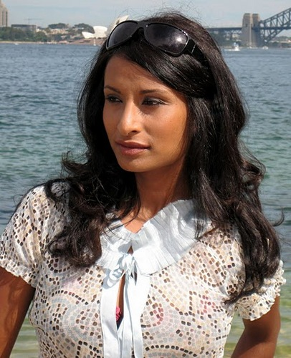
Niromi de Soyza
Niromi was born into a middle-class family and was given the possibility to live a comfortable and sheltered life.
When she was 17 years old she joined the organization and became a child soldier.
The book “Tamil Tigress” was written as a diary while she was in a boarding school after fleeing Sri Lanka.
She now lives in Australia, as well as her and Ajanthi’s family and has a degree in Biotechnology and Law.

Slide 4
1968
TELO emerges, initially as an unstructured militant group of Sri Lanka Tamil students
23.07.1983
Start of Civil War,
Black July Riots
1987
Peace contract between India and Sri Lanka,
IPKF arrives
31.5.1981 – 2.6.1981
Burning of Jaffna Public Library
06.05.1987
Niromi and Ajanthi join the LTTE
june 1987
Niromi is stationed in seaside ford
1986
Niromi joins SOLT
(Students Organisation of Liberation Tigers)
1970
Niromi de Soyza is born
may 1987
Amma decides she wants to flee to Kandy, Niromi runs away
1977
Niromi moves to Jaffna
06.06.1987
Niromi and Ajathi meet Akila and Kaanchana

Slide 5
1991
Assassination of former indian Prime minister Rajiv Gandhi
20.09.1989
Suspension of military operations
01.05.1993
President Ranasinghe Premadasa killed by an LTTE suicide bomber
03.1990
Withdrawal of Indian troops from Sri Lanka
aug.- sept. 1987
Niromi is sent home
sept. 1987
Niromi returns to the training camp
dec.1987
Niromi leaves the tigers
aug. 1988
Amma enrolls Niromi to an indian boarding school
15.09.1987
Thileepan’s hunger strike, dies 12 days later
jan. 1988
Amma founds the
Mothers Front Movement
oct. 1987
Niromi is sent to the battlefield

Slide 6
18.5.2009
End of Civil War,
Government defeats the LTTE,
Prabhakaran is killed
2002-2008
Ceasefire that is broken by both sides repeatedly
2004
New fraction of tigers that later work with the government against the tigers
1995
Akila dies at the age of 24
01.06.2011
Tamil Tigress is released on Ajanthi’s birthday

Slide 7
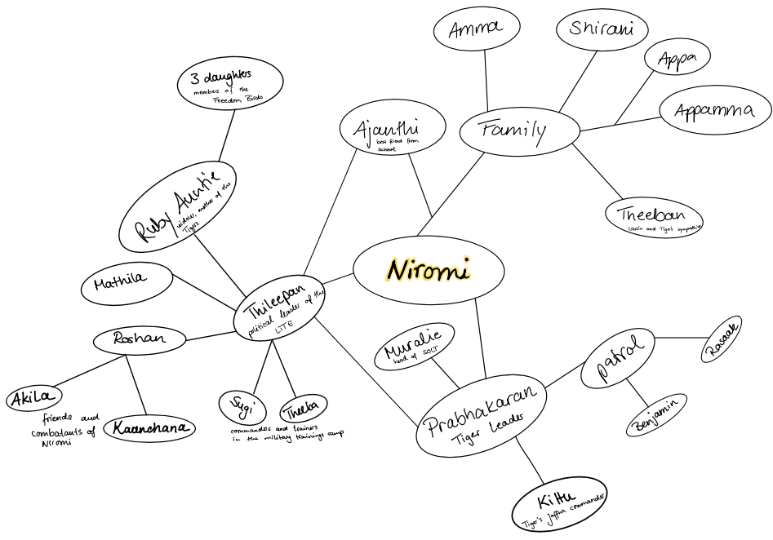

Slide 8
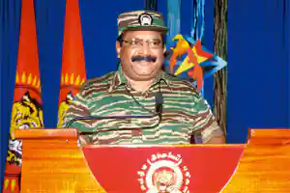
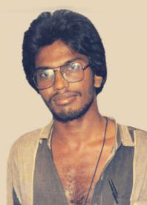
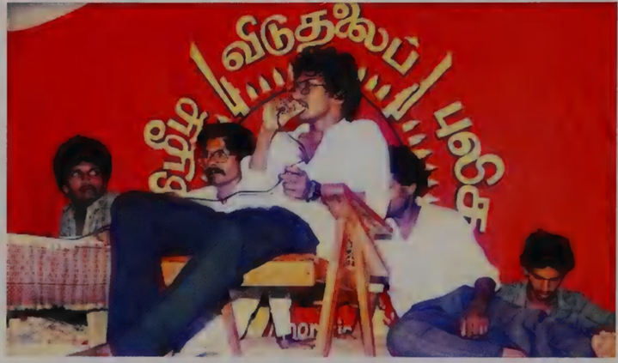
Thileepan & Prabhakaran
Prabhakaran
Thileepan giving speeches during his hunger strike

Slide 9
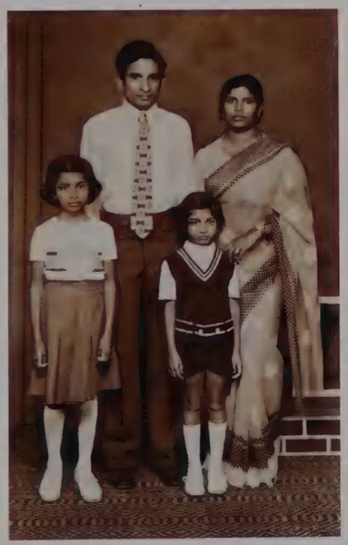
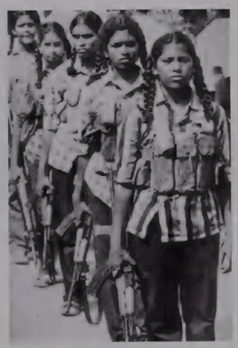
Niromi and her family 1978
Tamil Tigresses

Slide 10
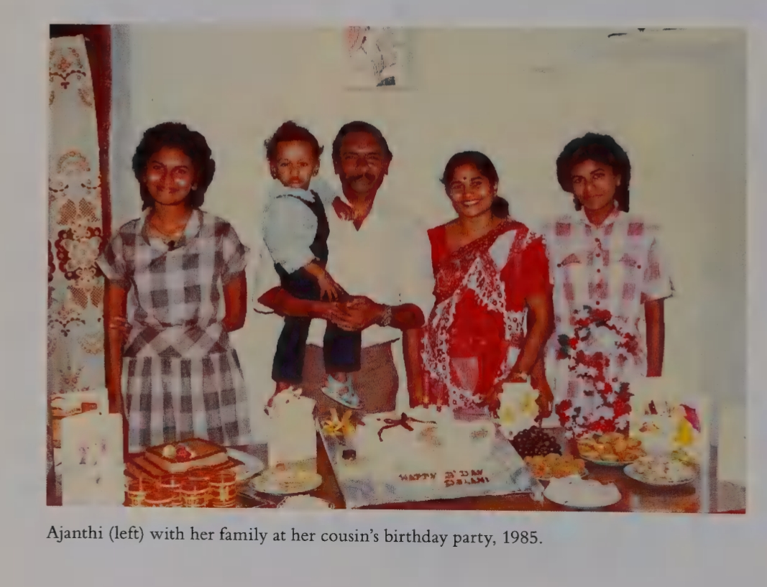

Slide 11

“I dedicate my heart, body and soul to fight for the sacred cause of our revolutionary movement, which is to attain a free, democratic Tamil nation and, as I say this, I wholeheartedly accept the guidance of our leader Prabhakaran and promise that I will dutifully work for him with honesty and dedication, and begin my training. Tigers thirst for Tamil Eelam motherland!”

Slide 12
Change of Niromis mindset
Chapter 6:
Shirani, Amma and Ajanthi’s family were waiting in the same room in which we had been interviewed by Thileepan the evening before. They sat with tears in their eyes and distress on their faces. As soon as I saw Shirani, emotion flooded over me. My legs turned into jelly, and tears burst from my eyes and ran down my face.
The second I stepped into the room, Amma became hysterical. “What have I ever done to you that you’d do this to me?’ she sobbed. “You were never left needing anything. And now you're throwing everything away—for what?’ Tears ran down her face like rivers. ‘I have everything, Amma, but the Tamils don’t have freedom,’ I tried to reason. ‘We must achieve Tamil Eelam for everyone.’
Chapter 15:
But I felt no anger, only despair. If life becomes death so swiftly, what was the point of the endless human struggle to make things permanent?
Chapter 19:
He’d know that I still believed in the Tamil cause, admired Prabhakaran, and cared about these young men and women, my comrades, who had become my family. But I wouldn’t be explaining to him that, while I shared their vision, I no longer shared their values.

Slide 13
Discussion questions
Is it easy to sympathize with Niromi’s character with the way she is portrayed and her actions?

Slide 14
Discussion questions
Is the portrayal of the war and the Tiger organisation, due to her young age and naiveness, realistic ?

Slide 15
Discussion questions
What could have caused her determination at such young age to join the Tigers?

Slide 16
Discussion questions
Does the writing style suit the plot and storyline?

Slide 17
Discussion questions
Can you make out turning points or increase of action?

Slide 18
Discussion questions
Why is it important that different perceptions of the war are portrayed?

Slide 19
Discussion questions
Why is it important for Niromi to publish her story after leaving her country and starting a new life in Australia?

Slide 20
Discussion questions
How would their lives change if a Tamil Eelam can be reached and how can the outcome of the war change her life?

Slide 21
Abbreviations
Mother’s Front (organisation of Niromi’s mother to find lost children)
Indian Peace Keeping Force (IPKF)
Liberation Tigers of Tamil Eelam (LTTE)
National Television of Tamil Eelam (NTE)
People's Liberation Organisation of Tamil Eelam (PLOTE)
Tamil Eelam Liberation Army/ Organisation (TELA/TELO)
JVP („Janatha Vimukthi Peramuna“)- national marxist and communist party
Sea Tigers - water force
Black Tigers- suicide fighters

Slide 22
Additional Sources
https://www.eelamview.com/2013/11/23/velupillai-prabhakaran-tamil-eelam-leaders-annual-speech/
https://images.app.goo.gl/NRKpCoKVPRfXo4RB7
https://www.spiegel.de/politik/ausland/sri-lanka-buergerkrieg-forderte-100-000-todesopfer-a-626093.html
https://www.nzz.ch/article8MRKP-ld.242635
http://www.niromidesoyza.com/
De Soyza, Niromi (2011). Tamil Tigress. My story as a child soldier in Sri Lankan’s bloody civil war
Marasinghe, M. (1988). Ethnic Politics and Constitutional Reform: The Indo-Sri Lankan Accord. International and Comparative Law Quarterly, 37(3), 551-587. doi:10.1093/iclqaj/37.3.551

