Slide 1


The Refugee Teachers Program a brief introduction to the reasons for and structure of the program
Prof. Miriam Vock
Refugee Teachers Program

Slide 2
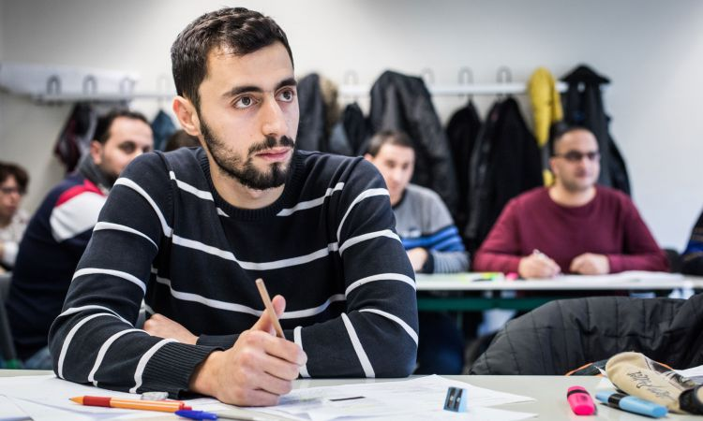
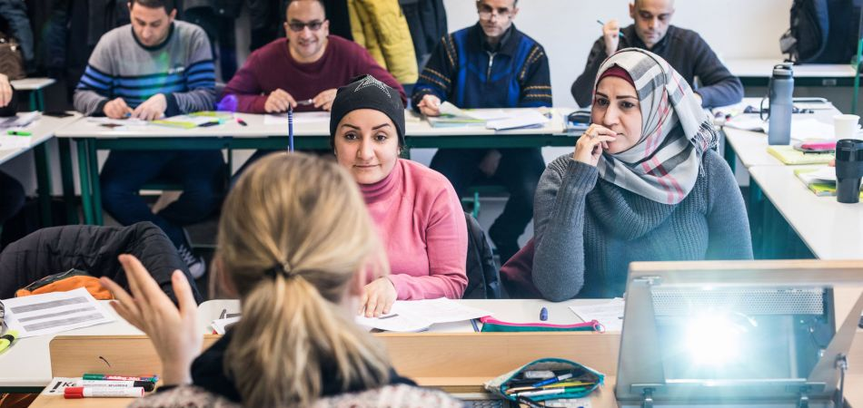
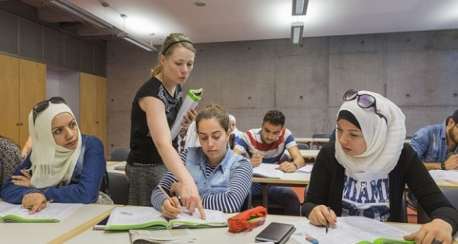
Contents
The current situation
Key points to the program
Establishment of the program at the University of Potsdam
Approaches to a new target group
Institutional barriers to entry into the teaching profession
Consequences for the conception of the qualification
Figures on participations and completions
References
© Stephan Pramme
© Stephan Pramme
© Rolf Schulten
Refugee Teachers Program

Slide 3
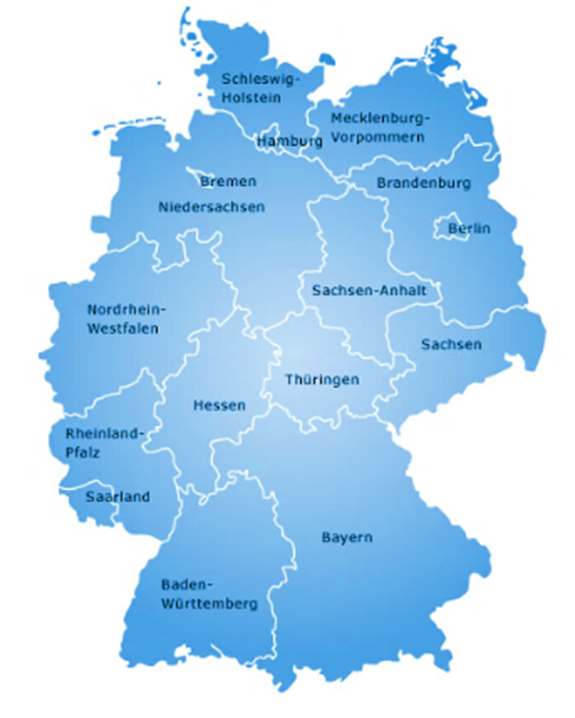






Numbers and countries of origin
since 2015
most common countries of origin of refugees since 2015
Syria
Afghanistan
Turkey
Iraq
Iran
Eritrea
Nigeria
Somalia
Georgia
Russian Federation
Number of asylum applications in Germany since 2015
Refugee Teachers Program

Slide 4

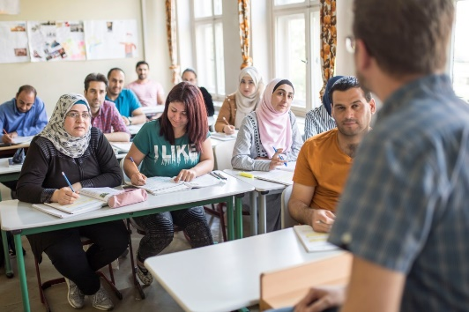
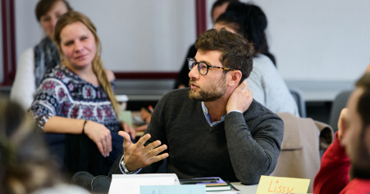
Key points to the program
Background: Response to refugee movements in 2015 - aimed at (re-)qualifying incoming teachers for the school service
Objective: To provide teachers with further linguistic, pedagogical and professional training and to help them enter the teaching profession in Germany
Curriculum: German courses, educational sciences/pedagogy, second subject, subject didactics, school visits, computer course, counselling & guidance.
Goal and career prospects: full recognition and accreditation as teacher in Brandenburg
Target Group: Refugee teachers with a university degree from abroad and with teaching experience
Degree: C1 Language Certificate and Pedagogical Certificate
Foto: Andreas Friese
© Stephan Pramme
Foto: Phil Dera
(cf. Wojciechowicz & Vock 219;
Wojciechowicz & Vock 2020b)
Refugee Teachers Program

Slide 5
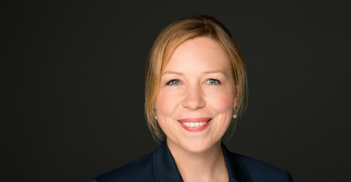
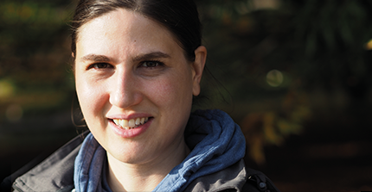
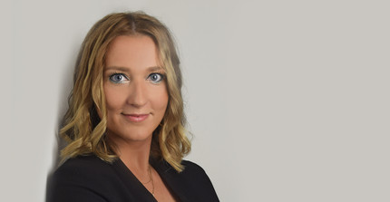
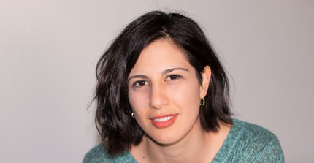
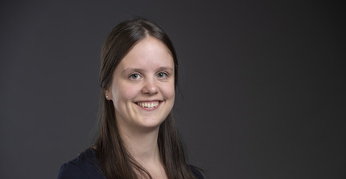
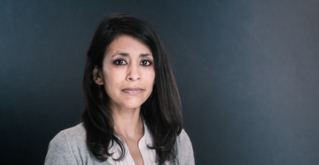
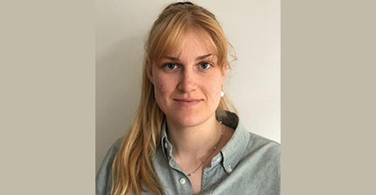
The RTP team
at the time of 12/2023
At the top:
Prof. Miriam Vock, Verena Maar,
Dr. Anna Aleksandra Wojciechowicz (on parental leave)
In the middle:
İlkim Kilinc, Marie Rüdiger
Below:
Diana Gonzalez Olivo,
Clea de Vries
Refugee Teachers Program

Slide 6
Establishment of the program at the University of Potsdam
Project phases: Funding phase 1 → April 2016 until March 2019
Funding phase 2 → April 2019 until March 2022
Funding phase 3 → April 2022 until March 2025
Structural localisation:
  Centre for Teacher Training and Educational Research (ZeLB)
  Professorship for Empirical Teaching and Intervention Research (Prof. Miriam Vock)
Involved institutions at the university:
Centre for Languages and Key Competences (Zessko)
Professorships in the subjects: Mathematics, Physics, Sports, WAT
Centre for Teacher Training and Educational Research (ZeLB)
Main funding: Ministry of Science, Research and Culture (MWFK)
Further financial support:
  German Academic Exchange Service – DAAD, Robert-Bosch-Foundation, Alliance for Brandenburg, Equal Opportunities Office at the University of Potsdam
Refugee Teachers Program

Slide 7
A new group in teacher education
Refugee teachers….
enter the school service differently prepared than student teachers and lateral entrants due to structural reasons:
  are biographically unfamiliar with the German school and university system
  have several years of professional experience as a teacher
  are familiar with the pedagogical and professional requirements of the teaching profession
  bring extensive knowledge of other educational systems outside of Germany
  are highly identified with the teaching profession
(cf. Wojciechowicz & Vock 2020a, p. 28 f.)
Refugee Teachers Program

Slide 8

Institutional barriers to accessing the teaching profession
Denegation instead of recognition
Teaching profession is a regulated profession in Germany
State-specific recognition regulations
A full recognition is necessary for accreditation
Generally none or only partial recognition, as the teacher training differs from that in Germany
Applications for accreditation in Berlin – Brandenburg
Year 2014 | 278 applications filed
Year 2017 | 646 apllications filed, of which:
40 (6%) fully recognized | 437 (67%) not recognized due to significant differences | 169 (26%) in process
(cf.. Statistisches Informationssystem Berlin Brandenburg 2018, own calculations)
(cf. Wojciechowicz & Vock 2020a, p. 26; Sommer 2015, p. 376)
Refugee Teachers Program

Slide 9
The road to becoming a teacher
(Sek. I)
State of Brandenburg
Syria
Regulated by Land legislation
Bachelor of Education
2 teaching subjects (subject-related sciences + subject-related didactics)
Educat. knowledge, pract. school studies
Duration: 3 years
No Regulation
Bachelor of Science / Arts
1 subject
Duration: 4 years
Master of Science / Arts
1 subject
Duration: 2 years
Master of Education
2 teaching subjects (subject-related sciences + subject-related didactics)
Educational sciences, practical semester Duration: 2 years
Pedagogical diploma
Duration: 1 year
Teacher training
Duration: 12 months
Determination of suitability via two examinations
Teacher
Teacher
Refugee Teachers Program

Slide 10
Contents of the program
individually adaptable
Language training courses
Target Level C1
Educational sciences
Second Teaching Object
possible: Mathematics, Physics, Computer Science, French, Art, Sports, WAT
Key skills of Teaching
Refugee Teachers Program

Slide 11
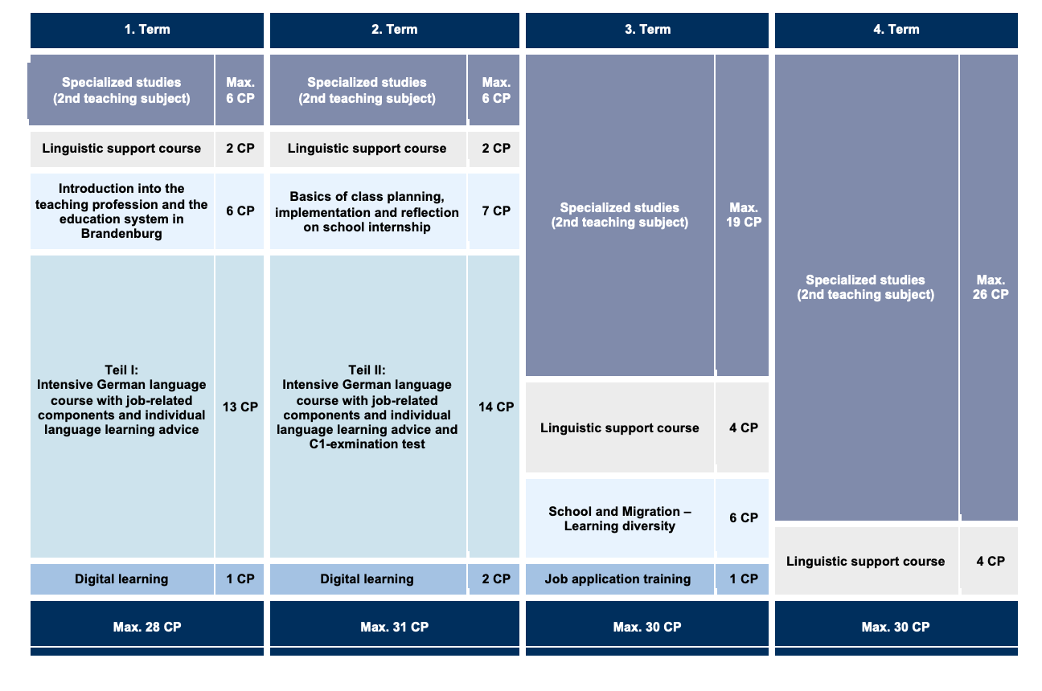
Structure of the training program
as of Nov 2020
Refugee Teachers Program

Slide 12



Figures on participation and completions
Status: September 2023
Applications
Admissions
Successful
Degrees
Withdrawals
April 2016
Group 1
≈ 640
50
Group 2
≈ 70
30
Group 3
≈ 220
30
Group 4
≈ 80
30
109
27%
April 2019
Group 5
≈ 115
27
April 2021
Group 6
≈ 36
10
April 2022
Group 7
≈ 21
11
April 2023
Group 8
≈ 24
15
Group 8u
≈ 20
5
Refugee Teachers Program

Slide 13
Gogolin, I., I. Lange, B. Hawighorst, C. Bainski, A. Heintze, S. Rutten und W. Saalmann (2011): Durchgängige Sprachbildung: Qualitätsmerkmale für den Unterricht. FörMig Material Bd. 3, Münster, New York, München und Berlin:
Waxmann.
Hertlein, A. und R. Leiprecht (2019): Der Versuch, globale Bildungsbiographien in nationale Hochschulstrukturen zu implementieren. Universitäre Angebote für Geflüchtete und Migrierte. In: Lucyna Darowska (Hrsg.), Diversity an der Universität, S. 179-224.
Kulturministerkonferenz (2011): Empfehlungen der Kulturministerkonferenz zur Stärkung der Fremdsprachenkompetenz, [online] https://www.kmk.org/fileadmin/Dateien/veroeffentlichungen_beschluesse/2011/2011_12_08-Fremdsprachenkompetenz.pdf [25.02.2020].
Sommer, Ilka (2015): Die Gewalt des Besserwissens. Kämpfe um die Anerkennung ausländischer Berufsqualifikationen in Deutrschland. Bielefeld: transcript.
Teichler, U. und A. Wolter (2004): Zugangswege und Studienangebote für nicht-traditionelle Studierende. In: Die Hochschule: Journal für Wissenschaft und Bildung 13 (2004) 2, S. 64-80.
Wojciechowicz, A. A. und M. Vock (2019): Wiedereinstieg in den Lehrerberuf nach der Flucht mit dem Refugee Teachers Program in Brandenburg. In: Die Deutsche Schule, 111. Jahrgang, Heft 2/2019, S. 219-229.
Wojciechowicz, A. A. und M. Vock (2020a): Deutschland in Zeiten der Fluchtmigration – Neue Entwicklungen und Neuorientierungen in der Lehrer/innen-Bildung? In: Anna Aleksandra Wojciechowicz, Daniela Niesta Kayser & Miriam Vock (Hrsg.): Lehrer/innen- Bildung im Kontext aktueller Fluchtmigration. Perspektiven, Impulse, Erkundungen, S. 18- 34.
References
Refugee Teachers Program

Slide 14
Wojciechowicz, A. A. und M. Vock (2020a): Deutschland in Zeiten der Fluchtmigration – Neue Entwicklungen und Neuorientierungen in der Lehrer/innen-Bildung? In: Anna Aleksandra Wojciechowicz, Daniela Niesta Kayser & Miriam Vock (Hrsg.): Lehrer/innen- Bildung im Kontext aktueller Fluchtmigration. Perspektiven, Impulse, Erkundungen, S. 18- 34.
Wojciechowicz, A. A. und M. Vock (2020b): Geflüchtete Lehrkräfte für die Arbeit an Schulen in Deutschland qualifizieren – das Modelprojekt Refugee Teachers Program der Universität Potsdam. In: Anna Aleksandra Wojciechowicz, Daniela Niesta Kayser & Miriam Vock (Hrsg.): Lehrer/innen-Bildung im Kontext aktueller Fluchtmigration. Perspektiven, Impulse, Erkundungen, S. 100-113.
Wojciechowicz, A. A. und M. Vock (2020c): „Wenn ich aufstehe, weiß ich nicht genau, was heute passiert“ – Eine qualitative Studie zum Berufseinstieg aus der Sicht von geflüchteten Lehrkräften. In: Anna Aleksandra Wojciechowicz, Daniela Niesta Kayser & Miriam Vock (Hrsg.): Lehrer/innen-Bildung im Kontext aktueller Fluchtmigration. Perspektiven, Impulse, Erkundungen, S. 114-125.
Yildiz, C., N. Topaj, R. Thomas und I. Gülzow (2017): Die Zukunft der Mehrsprachigkeit im deutschen Bildungssystem. Russisch und Türkisch im Fokus. 3. Berlin-Brandenburger Positionspapier zur Mehrsprachigkeit im deutschen Bildungssystem. Frankfurt am Main: Peter Lang Edition.
References
Refugee Teachers Program

Slide 15
Thank you
for your attention!
Refugee Teachers Program

