Slide 1


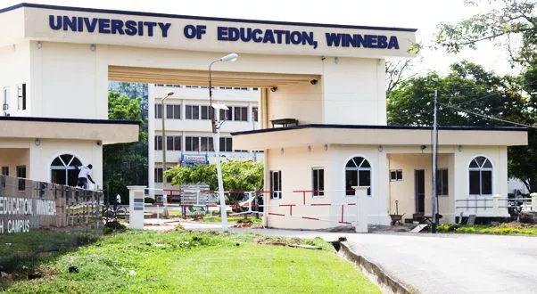
TEACHER EDUCATION AND THE SCHOOL SYSTEM IN GHANA
Prof. Dr. Dandy George Dampson

Slide 2
Outline of Presentation
HISTORY
1
Historical Context of Education in Ghana
STURCTURE
Structure of Education System in Ghana – Overview
2
BAS. SEC
The School system in Ghana – Basic and Secondary
3
TERTIARY
The School System in Ghana - Tertiary
4
TEACH. EDUC
Teacher Education in Ghana - Overview
5

Slide 3
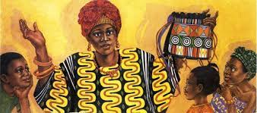
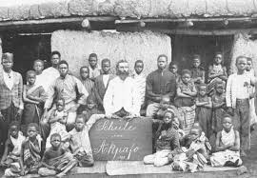
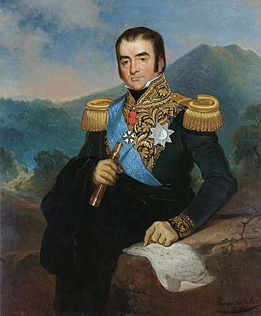

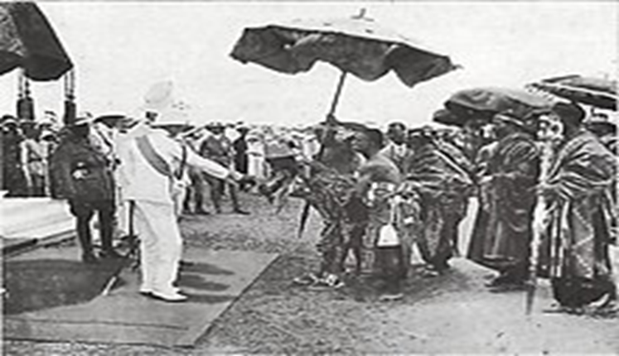
Historical Context of Education in Ghana
Traditional System
of Education
Western/European System of Education
British System of Education

Slide 4
Structure of Education system in Ghana – Overview
Kindergarten – UP
4- 9Yrs
Secondary & Tertiary
Tertiary
Senior High School
Basic Education
Junior High School
Upper Primary
Lower Primary
Primary 4-6
9-12Yrs
Universities
JHS
12-15Yrs
Technical Universities
Secondary, Voc & Tech, STEM
Colleges of Education

Slide 5
Structure of Education system in Ghana – Overview
Basic Education
11 years
Secondary Education
3 years
Tertiary Education
4 years
Basic Education Certificate Examination (BECE)
West Africa Senior School Certificate Examination (WASSCE)
Tertiary Education Examination (TEE)

Slide 6
The School System in Ghana – Basic
Basic Education
4 – 15 years
Kindergarten
6 Core Subjects
4- 6 years
Primary
13-14 Subjects
6 -11 years
Junior Sec Sch
11- 12 Subjects
12 – 15 years

Slide 7
The School System in Ghana – Primary
First Term | Second Term | Third Term
In School Break | In School Break | In School Break
10th January to 21st April to 20th April 1st May 2023 2023 | 2nd May to 10th August to 9th August 21st August 2023 2023 | 22nd August to 16th November 2023
Academic Calendar - 14 WEEKS a term
Teaching Time Table
Class | Day/Time | 7:45-8:00 | 8:00-9:00 | 9:00-10:00 | 10:00- 10:30 | 10:30-11:30 | 11:30-12:30 | 12:30 - 1:00 | 1:00 - 2:00 | 2:00 – 2:30
4 | Mon | Assembly | Math | Creative Art | BREAK | English | Science | BREAK | Fante | Library
5 | Mon | Registration | English | Math | BREAK | Creative Art | History | BREAK | Science | Computing
6 | Mon |  | Creative Art | English | BREAK | OWOP | Math | BREAK | History | Science

Slide 8
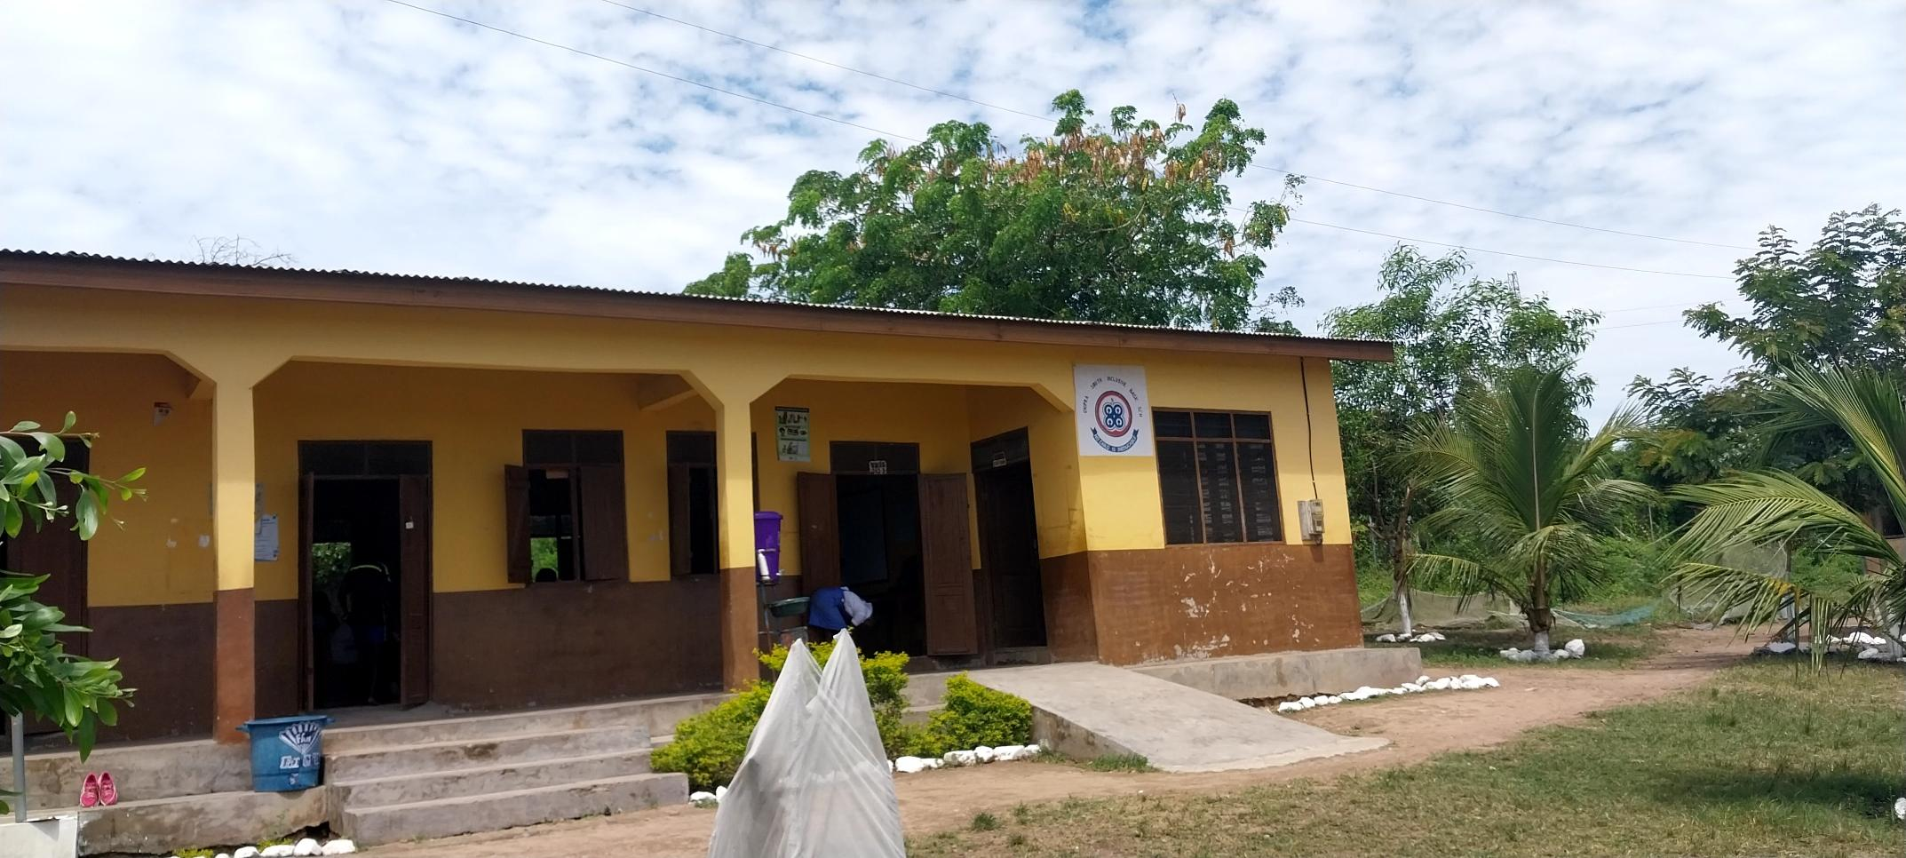
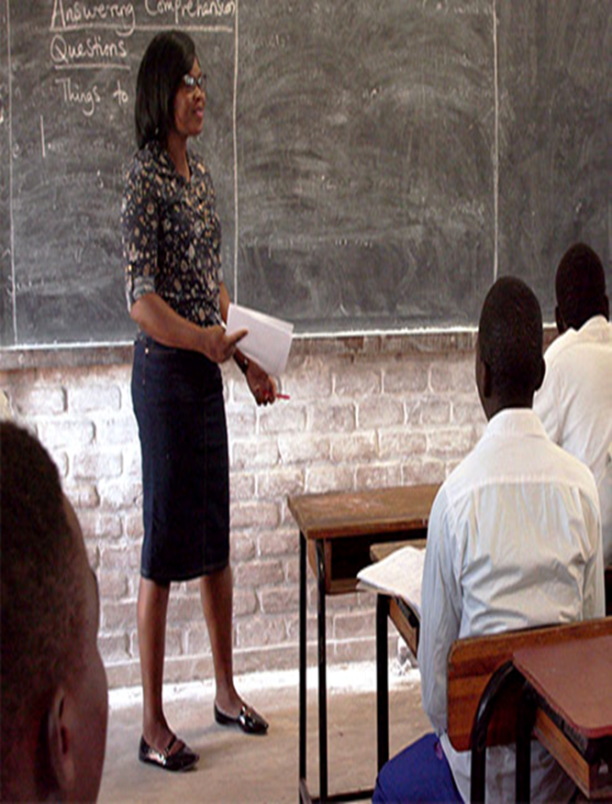
The School Building – Primary

Slide 9
The School System in Ghana – JHS
First Term | Second Term | Third Term
In School Break | In School Break | In School Break
10th January to 21st April to 20th April 1st May 2023 2023 | 2nd May to 10th August to 9th August 21st August 2023 2023 | 22nd August to 16th November 2023
Academic Calendar - 14 WEEKS a term
Teaching Time Table
Class | Day/Time | 7:45-8:00 | 8:00-9:10 | 9:10-10:20 | 10:20- 10:50 | 10:50-12:00 | 12:00-1:10 | 1:10 - 1:30 | 1:30 - 2:05 | 2:05 – 3:05
7 | Mon | Assembly | Math | English | BREAK | Soc. Studies | Creative Art | BREAK | Computing | Intervention
8 | Mon | Registration | Fante | Computing | BREAK | Int. Science | Soc. Studies | BREAK | PE | Intervention
9 | Mon |  | Soc Studies | Int. Science | BREAK | English | Math | BREAK | RME

Slide 10
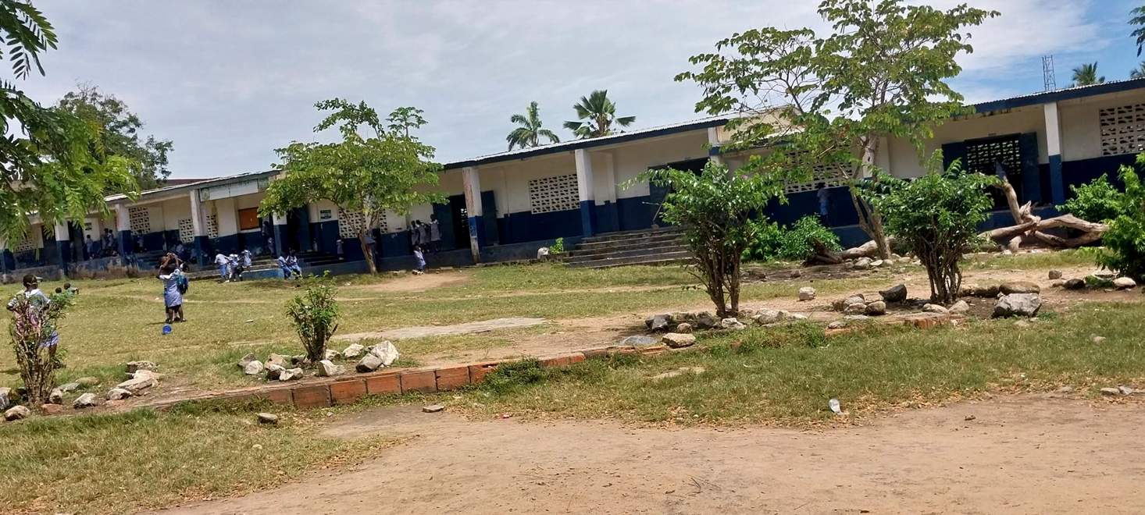
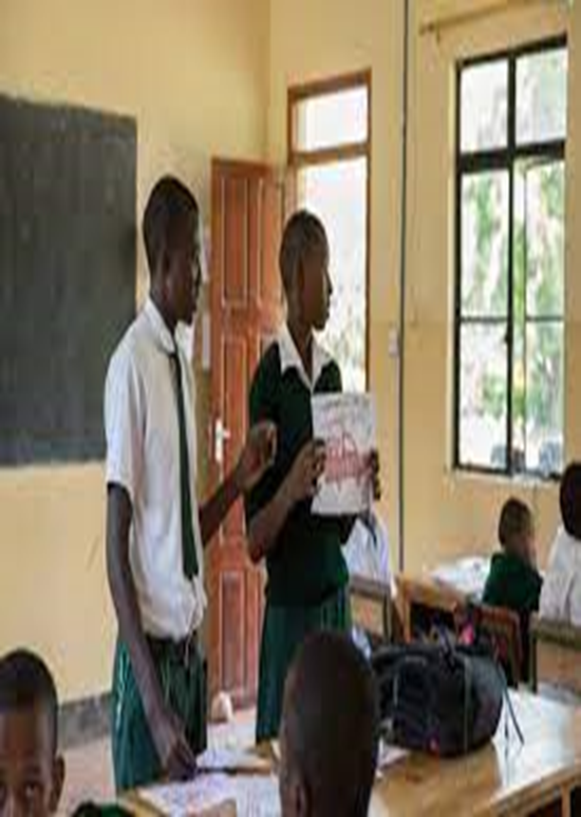
The School Building – JHS

Slide 11
The School System in Ghana – SHS
Senior High School
3 years (15-19)
Technical SHS
3 years
STEM SHS
3 years
Traditional SHS
3 years

Slide 12
The School System in Ghana – SHS
 | SEMESTER 1 - 2023 |  | VACATION |  | SEMESTER 2 - 2023
FORM | From | To | From | To | From | To
SHS 3 | 9th January | 11th May | 12th May | 2nd June | 5th June | 29th September
SHS 2 | 9th January | 11th May | 12th May | 2nd June | 5th June | 9th October
SHS 1 | 20th January | 11th May | 12th May | 2nd June | 5th June | 10th November
Academic Calendar - 34 WEEKS a term
Teaching Time Table – Course based
Class | Day/Time | 7:30-8:50 | 8:50-9:20 | 9:20-10:40 | 10:40- 12:00 | 12:00-12:40 | 12:40 - 1:10 | 1:10 - 1:50 | 1:50 – 3:10
SHS3A | Mon | Core Math | Break F. | French/Fante | History/Lit | Social Stud. | Break L. | Social Stud | English
SHS2B | Mon | English | Break F. | E. Math | BREAK | Economics | Break L. | Core Math | Bus Man

Slide 13
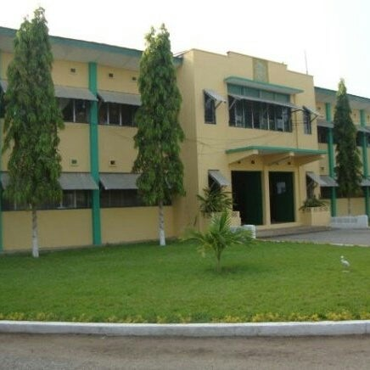
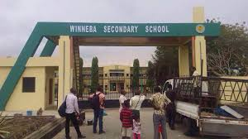
The School Building – SHS

Slide 14
The School System in Ghana – Tertiary
Tertiary
4 years (20-)
Colleges of Education
(48)
4 years
Universities
(15)
4 years
Technical Universities
(10)
3- 4 year

Slide 15
Teacher Education in Ghana
Teacher Education
4 years (20-)
Colleges of Education
(48)
4 years
Universities
(1)
4 year

Slide 16
Teacher Education in Ghana – The Reforms
Reforms of Teacher Education in Ghana
Education Act in 2008 (Act 778) which created the National Teaching Council; to professionalize the teacher through licensing
Colleges of Education Act in 2012 (Act 847) which upgraded Colleges of Education into Tertiary Institutions
Pre Tertiary Teacher Professional Development and Management (PTPDM) Policy in 2012, to design to career progression path for teachers in Ghana
1. Career program
2. School Leadership and Management
3. Continuous Professional development
4. Teacher Assessment Framework

Slide 17

Teacher Education in Ghana - Programs
Secondary
Science/Math
Upper Primary
subjects
Early grade
Subjects
JHS
Economic
Political Sci
Early Grade
Upper Primary
JHS
Colleges of Education
Universities

Slide 18
Career Progression in Teacher Education - Ghana
Early Grade Education
Upper Primary Education
Junior High School Educ
Generic Courses in Education – STS 1-3
Specialism Courses – On and Off Campus Teaching Practice
Subject based – SHS
Arts/Humanities
Sciences
Do observation
Peer teaching
Teaching

Slide 19
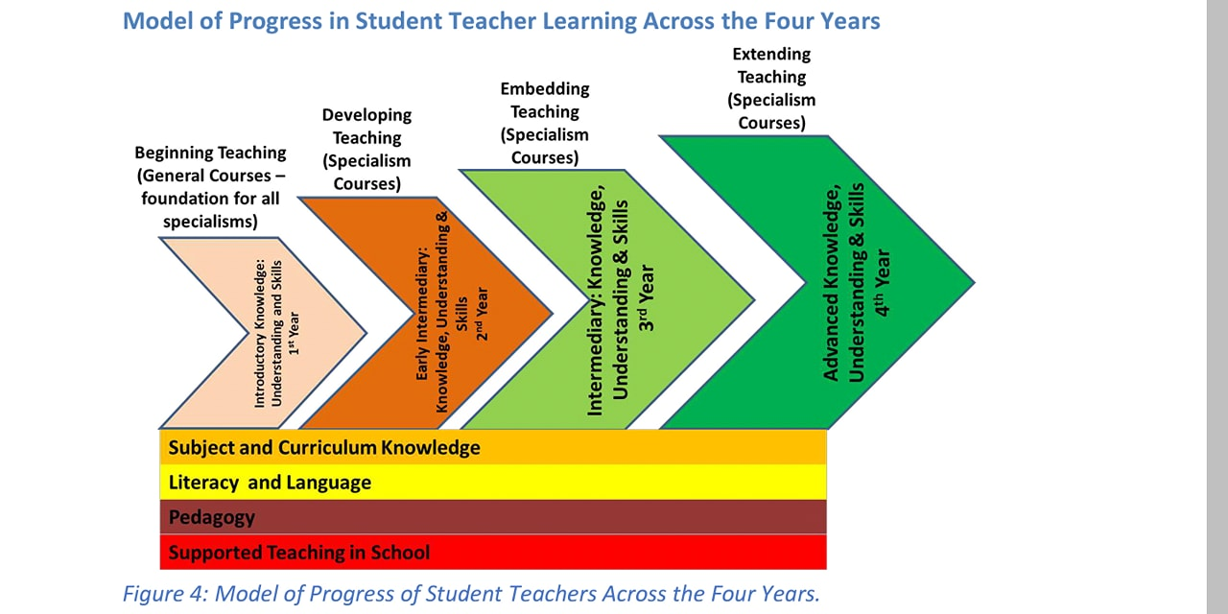
Career Progression in Teacher Education - Ghana

Slide 20
Who is a Qualified Teacher in Ghana
Successfully completed 4year Bachelor of Education
Must have passed the licensure examination
Issued for provisional license valid for 4 years
Expected to go through continuous professional development
towards their full license

Slide 21


•

